Slide 1


Evolving Neuro-Fuzzy Systems in Modelling and Control
Miha Ožbot, Igor Škrjanc
Ljubljana, 25th Maj 2022

Slide 2
Evolving (Intelligent) Systems
Evolving intelligent systems adapt their parameters as well as structure with a single-pass over the data [1] in an online manner in real time [2].
The environment is unknown and the model is built from scratch without a priori information about the model structure (number of rules , prototypes, centres).
fuzzy rules [1,3], information granules [4,5], neurons [6], decision tree [7], interval, etc.
Better Transparency and in linguistic interpretability [6].
[1] Angelov, P. P., & Filev, D. P. (2004). An Approach to Online Identification of Takagi-Sugeno Fuzzy Models. IEEE Transactions on Systems, Man, and Cybernetics, Part B: Cybernetics, 34(1), 484–498.
[2] Skrjanc, I. (2020). Cluster-Volume-Based Merging Approach for Incrementally Evolving Fuzzy Gaussian Clustering-eGAUSS+. IEEE Transactions on Fuzzy Systems, 28(9), 2222–2231.
[3] Dovžan, D., Logar, V., & Škrjanc, I. (2015). Implementation of an Evolving Fuzzy Model (eFuMo) in a Monitoring System for a Waste-Water Treatment Process. IEEE Transactions on Fuzzy Systems, 23(5), 1761–1776.
[4] Leite, D., Andonovski, G., Skrjanc, I., & Gomide, F. (2020). Optimal rule-based granular systems from data streams. IEEE Transactions on Fuzzy Systems, 28(3), 583–596.
[5] Leite, D., Costa, P., & Gomide, F. (2010). Granular Approach for Evolving System Modeling. Lecture Notes in Computer Science (Including Subseries Lecture Notes in Artificial Intelligence and Lecture Notes in Bioinformatics), 6178 LNAI, 340–349.
[6] Leite, D., Škrjanc, I., & Gomide, F. (2020). An overview on evolving systems and learning from stream data. Evolving Systems, 11(2), 181–198.
[7] Lemos, A., Caminhas, W., & Gomide, F. (2010). Evolving fuzzy linear regression trees. 2010 IEEE World Congress on Computational Intelligence, WCCI 2010.
Notes:
Samorazvijajoče se modele lahko razdelimo v različne kategorije gleda na njihovo strukturo, način učenja, nivo avtonomije adaptacije [39]
[3] Angelov, P. P., & Filev, D. P. (2004). An Approach to Online Identification of Takagi-Sugeno Fuzzy Models. IEEE Transactions on Systems, Man, and Cybernetics, Part B: Cybernetics, 34(1), 484–498.
[5] Dovžan, D., Logar, V., & Škrjanc, I. (2015). Implementation of an Evolving Fuzzy Model (eFuMo) in a Monitoring System for a Waste-Water Treatment Process. IEEE Transactions on Fuzzy Systems, 23(5), 1761–1776.
[7] Leite, D., Andonovski, G., Skrjanc, I., & Gomide, F. (2020). Optimal rule-based granular systems from data streams. IEEE Transactions on Fuzzy Systems, 28(3), 583–596.
[10] Leite, D., Škrjanc, I., & Gomide, F. (2020). An overview on evolving systems and learning from stream data. Evolving Systems, 11(2), 181–198.
[11] Leite, D., Costa, P., & Gomide, F. (2010). Granular Approach for Evolving System Modeling. Lecture Notes in Computer Science (Including Subseries Lecture Notes in Artificial Intelligence and Lecture Notes in Bioinformatics), 6178 LNAI, 340–349.
[16] Dovzan, D., & Skrjanc, I. (2020). Fuzzy Space Partitioning Based on Hyperplanes Defined by Eigenvectors for Takagi-Sugeno Fuzzy Model Identification. IEEE Transactions on Industrial Electronics, 67(6), 5144–5153.
[42] Lemos, A., Caminhas, W., & Gomide, F. (2010). Evolving fuzzy linear regression trees. 2010 IEEE World Congress on Computational Intelligence, WCCI 2010.

Slide 3
Evolving (Intelligent) Systems
Modelling, identification, inference, control, prediction, clustering, classification, fault detection, anomaly detection, image recognition [8], decision support, soft sensor [8] and self-calibrating sensors.
Monographies on evolving systems:
  Evolving Connectionist Systems (2007),
  Evolving Intelligent System – Methodology and Applications (2010),
  Evolving Fuzzy Systems Methodologies, Advanced Concepts and Applications (2011)
[6] Leite, D., Škrjanc, I., & Gomide, F.a (2020). An overview on evolving systems and learning from stream data. Evolving Systems, 11(2), 181–198.
[8] Lughofer, E. (2013). On-line assurance of interpretability criteria in evolving fuzzy systems – Achievements, new concepts and open issues. Information Sciences, 251, 22–46.
Notes:
[10] Leite, D., Škrjanc, I., & Gomide, F. (2020). An overview on evolving systems and learning from stream data. Evolving Systems, 11(2), 181–198.
[12] Lughofer, E. (2013). On-line assurance of interpretability criteria in evolving fuzzy systems – Achievements, new concepts and open issues. Information Sciences, 251, 22–46.

Slide 4
Data Streams
Properties:
Data samples arrive online and one-by-one
Data are generated as long as the process is active, and they are not limited in quantity
Data characteristics are time-varying with nonstationary shift and drift phenomena
Samples are discarded immediately after processing
Processing time should scale efficiently with data size and the number of model parameters
Sources: high-frequency trading, data mining, cyber security, medical prognosis, smart industry, logistics, social networks, internet of things [6], [9], [10] etc.
[6] Leite, D., Škrjanc, I., & Gomide, F. (2020). An overview on evolving systems and learning from stream data. Evolving Systems, 11(2), 181–198.
[9] Blazic, S., & Skrjanc, I. (2020). Hybrid system identification by incremental fuzzy C-regression clustering. IEEE International Conference on Fuzzy Systems, 2020-July.
[10] Angelov, P. P., Gu, X., & Principe, J. C. (2018). Autonomous learning multimodel systems from data streams. IEEE Transactions on Fuzzy Systems, 26(4), 2213–2224.
Notes:
[10] Leite, D., Škrjanc, I., & Gomide, F. (2020). An overview on evolving systems and learning from stream data. Evolving Systems, 11(2), 181–198.
[45] Angelov, P. P., Gu, X., & Principe, J. C. (2018). Autonomous learning multimodel systems from data streams. IEEE Transactions on Fuzzy Systems, 26(4), 2213–2224.
[31] Blazic, S., & Skrjanc, I. (2020). Hybrid system identification by incremental fuzzy C-regression clustering. IEEE International Conference on Fuzzy Systems, 2020-July.

Slide 5
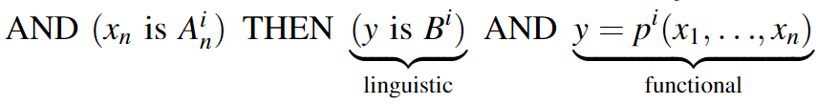
Evolving Fuzzy Systems
Fuzzy models
  fuzzy sets in the antecedent part,
  local linear models in the consequent part.
Main tasks of fuzzy models
  precise function modelling with Takagi-Sugeno-Kang type,
  linguistic modelling of Zadeh-Mamdani type,
  classification.
Output defuzzification is done with a centre of gravity for linguistic outputs, weighted average for function outputs and winner-takes-all approach for classification tasks.
[11]
[11] Leite, D., Ballini, R., Costa, P., & Gomide, F. (2012). Evolving fuzzy granular modeling from nonstationary fuzzy data streams. Evolving Systems, 3(2), 65–79.

Slide 6
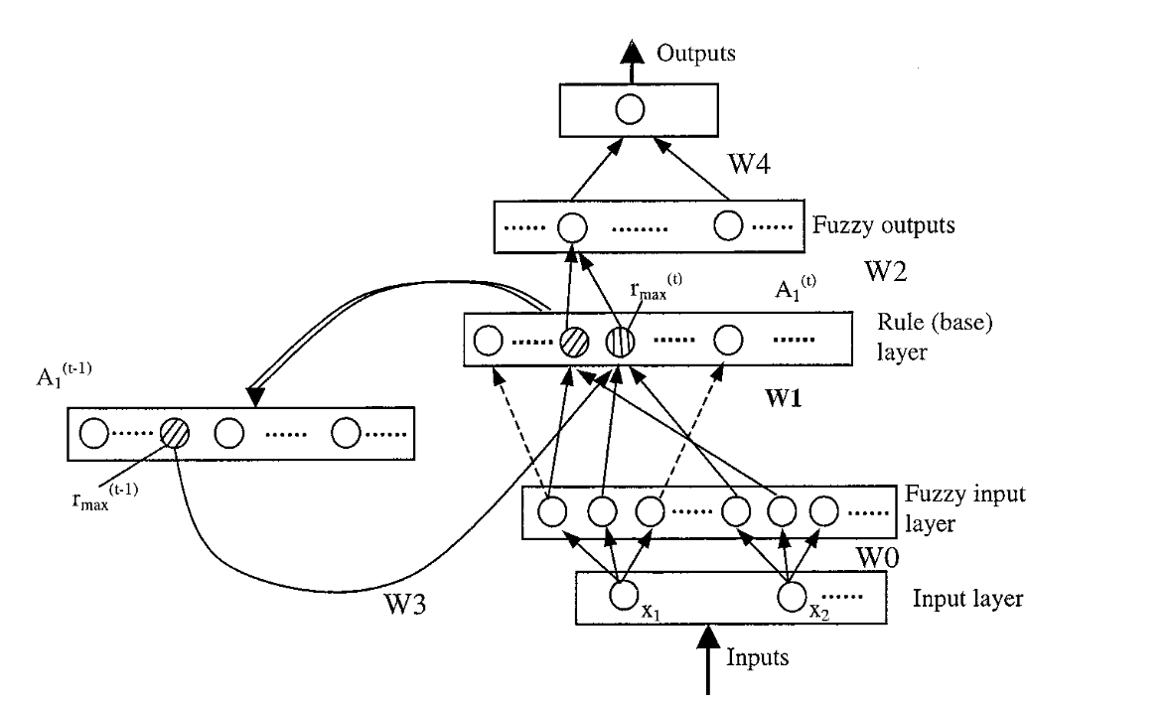
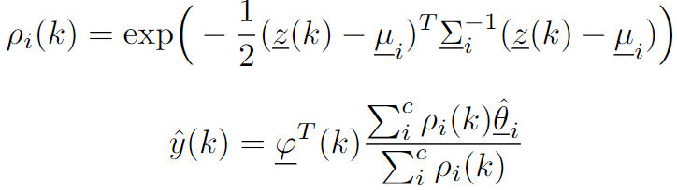
Evolving Neuro-Fuzzy Models
[13]
Neuro-fuzzy models have a neural network topology with neurons and connections [6].
A fuzzy rule can be defined by multiple fuzzy set [12]. Neuro-fuzzy systems use one cluster for each rule, which simplifies the adaptation of the structure with merging, splitting and removal.
Clusters can be transformed into fuzzy sets.
[6] Leite, D., Škrjanc, I., & Gomide, F. (2020). An overview on evolving systems and learning from stream data. Evolving Systems, 11(2), 181–198.
[12] Angelov, P., & Yager, R. (2011). Simplified fuzzy rule-based systems using non-parametric antecedents and relative data density. IEEE SSCI 2011: Symposium Series on Computational Intelligence - EAIS 2011: 2011 IEEE Workshop on Evolving and Adaptive Intelligent Systems, 62–69.
[13] Kasabov, N. K., & Song, Q. (2002). DENFIS: Dynamic evolving neural-fuzzy inference system and its application for time-series prediction. IEEE Transactions on Fuzzy Systems, 10(2), 144–154.
Notes:
[10] Leite, D., Škrjanc, I., & Gomide, F. (2020). An overview on evolving systems and learning from stream data. Evolving Systems, 11(2), 181–198.
[41] Angelov, P., & Yager, R. (2011). Simplified fuzzy rule-based systems using non-parametric antecedents and relative data density. IEEE SSCI 2011: Symposium Series on Computational Intelligence - EAIS 2011: 2011 IEEE Workshop on Evolving and Adaptive Intelligent Systems, 62–69.
[4] Kasabov, N. K., & Song, Q. (2002). DENFIS: Dynamic evolving neural-fuzzy inference system and its application for time-series prediction. IEEE Transactions on Fuzzy Systems, 10(2), 144–154.

Slide 7
Transparency and Interpretability
Distinguishability – no overlapping, no redundant structures,
Simplicity – parsimonious structure, complexity-accuracy tradeoff,
Consistency – clusters with dissimilar consecutive must have dissimilar antecedents,
Coverage and completeness – fully defined structure,
Interpretability of the consequent part,
Feature importance,
Rule importance.
[8] Lughofer, E. (2013). On-line assurance of interpretability criteria in evolving fuzzy systems – Achievements, new concepts and open issues. Information Sciences, 251, 22–46.
Notes:
Razločljivost (Distinguishability ) – brez prekrivanja (overlapping), brez odvečnih struktur [12]
Preprostost (simplicity ) – čim manj rojev, kompromis med natančnostjo in kompleksnotjo
Konsistentnost (consistency) – roji z različnimi posledičnimi deli morajo biti ločeni
Pokritost (coverage) in popolnost modela (completeness) - celoten prostor naj bi bil pokrit z roji
Interpretabilnost posledičnega dela
Pomembnost značilk
Pomembnost pravil
[12] Lughofer, E. (2013). On-line assurance of interpretability criteria in evolving fuzzy systems – Achievements, new concepts and open issues. Information Sciences, 251, 22–46.

Slide 8
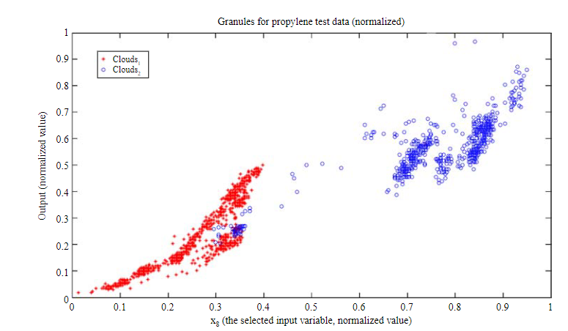
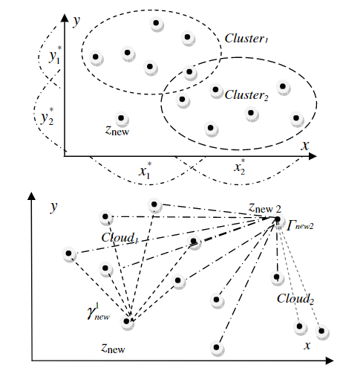
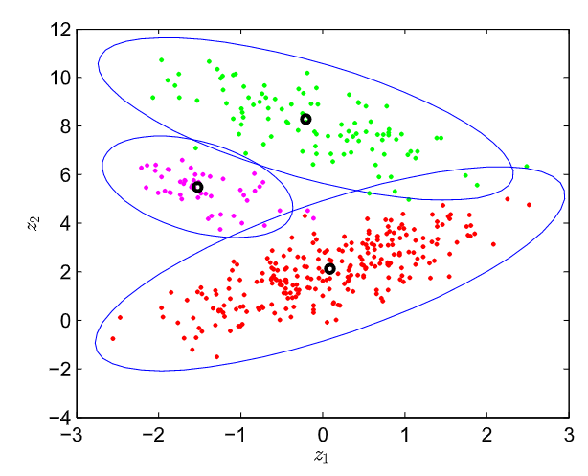
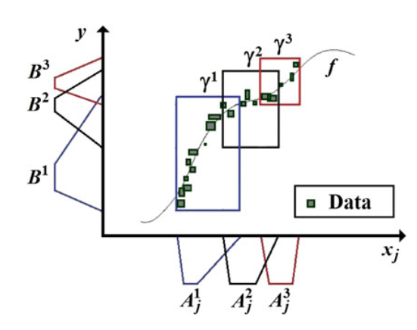
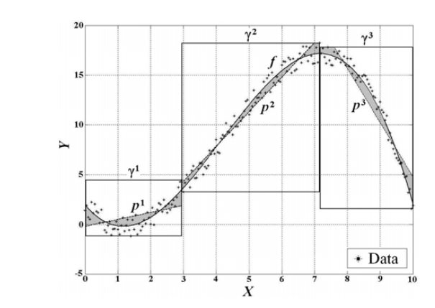
Clustering and Granulation
[15]
[12]
[2]
Antecedent structure: fuzzy sets[1], information granules [14, 5 ,11], leaves, neurons, data clouds [12,15], clusters [3, 14, 2], hyperplanes [16], tessellations [9] etc.
Cluster membership functions [10]:
Gaussian,
trapezoidal
triangular
Information granules are groups of objects or elements with similar properties, functionality or spatial proximity [12], [5].
[11]
[5]
[1] Angelov, P. P., & Filev, D. P. (2004). An Approach to Online Identification of Takagi-Sugeno Fuzzy Models. IEEE Transactions on Systems, Man, and Cybernetics, Part B: Cybernetics, 34(1), 484–498.
[2] Skrjanc, I. (2020). Cluster-Volume-Based Merging Approach for Incrementally Evolving Fuzzy Gaussian Clustering-eGAUSS+. IEEE Transactions on Fuzzy Systems, 28(9), 2222–2231.
[3] Dovžan, D., Logar, V., & Škrjanc, I. (2015). Implementation of an Evolving Fuzzy Model (eFuMo) in a Monitoring System for a Waste-Water Treatment Process. IEEE Transactions on Fuzzy Systems, 23(5), 1761–1776.
[5] Leite, D., Costa, P., & Gomide, F. (2010). Granular Approach for Evolving System Modeling. Lecture Notes in Computer Science (Including Subseries Lecture Notes in Artificial Intelligence and Lecture Notes in Bioinformatics), 6178 LNAI, 340–349.
[9] Blazic, S., & Skrjanc, I. (2020). Hybrid system identification by incremental fuzzy C-regression clustering. IEEE International Conference on Fuzzy Systems, 2020-July.
[10] Angelov, P. P., Gu, X., & Principe, J. C. (2018). Autonomous learning multimodel systems from data streams. IEEE Transactions on Fuzzy Systems, 26(4), 2213–2224.
[11] Leite, D., Ballini, R., Costa, P., & Gomide, F. (2012). Evolving fuzzy granular modeling from nonstationary fuzzy data streams. Evolving Systems, 3(2), 65–79.
[12] Angelov, P., & Yager, R. (2011). Simplified fuzzy rule-based systems using non-parametric antecedents and relative data density. IEEE SSCI 2011: Symposium Series on Computational Intelligence - EAIS 2011: 2011 IEEE Workshop on Evolving and Adaptive Intelligent Systems, 62–69.
[14] Porto, A., & Gomide, F. (2022). Evolving hyperbox fuzzy modeling. Evolving Systems, 1, 1–12.
[15] Angelov, P., & Yager, R. (2012). A new type of simplified fuzzy rule-based system. International Journal of General Systems, 41(2), 163–185.
Notes:
Dejanska porazdelitev podatkov se lahko zelo razlikuje od pripadnostnih funkciji.
[45] Angelov, P. P., Gu, X., & Principe, J. C. (2018). Autonomous learning multimodel systems from data streams. IEEE Transactions on Fuzzy Systems, 26(4), 2213–2224.
[3] Angelov, P. P., & Filev, D. P. (2004). An Approach to Online Identification of Takagi-Sugeno Fuzzy Models. IEEE Transactions on Systems, Man, and Cybernetics, Part B: Cybernetics, 34(1), 484–498.
[9] Porto, A., & Gomide, F. (2022). Evolving hyperbox fuzzy modeling. Evolving Systems, 1, 1–12.
[11] Leite, D., Costa, P., & Gomide, F. (2010). Granular Approach for Evolving System Modeling. Lecture Notes in Computer Science (Including Subseries Lecture Notes in Artificial Intelligence and Lecture Notes in Bioinformatics), 6178 LNAI, 340–349.
[41] Angelov, P., & Yager, R. (2011). Simplified fuzzy rule-based systems using non-parametric antecedents and relative data density. IEEE SSCI 2011: Symposium Series on Computational Intelligence - EAIS 2011: 2011 IEEE Workshop on Evolving and Adaptive Intelligent Systems, 62–69.
[46] Angelov, P., & Yager, R. (2012). A new type of simplified fuzzy rule-based system. International Journal of General Systems, 41(2), 163–185.
[5] Dovžan, D., Logar, V., & Škrjanc, I. (2015). Implementation of an Evolving Fuzzy Model (eFuMo) in a Monitoring System for a Waste-Water Treatment Process. IEEE Transactions on Fuzzy Systems, 23(5), 1761–1776.
[9] Porto, A., & Gomide, F. (2022). Evolving hyperbox fuzzy modeling. Evolving Systems, 1, 1–12.
[43] Skrjanc, I. (2020). Cluster-Volume-Based Merging Approach for Incrementally Evolving Fuzzy Gaussian Clustering-eGAUSS+. IEEE Transactions on Fuzzy Systems, 28(9), 2222–2231.
[16] Dovzan, D., & Skrjanc, I. (2020). Fuzzy Space Partitioning Based on Hyperplanes Defined by Eigenvectors for Takagi-Sugeno Fuzzy Model Identification. IEEE Transactions on Industrial Electronics, 67(6), 5144–5153.
[54] Leite, D., Ballini, R., Costa, P., & Gomide, F. (2012). Evolving fuzzy granular modeling from nonstationary fuzzy data streams. Evolving Systems, 3(2), 65–79.

Slide 9



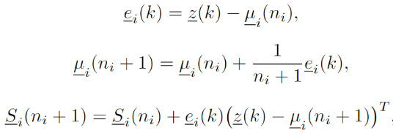
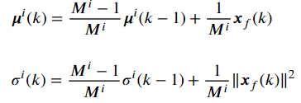
Clustering Methods
[19]
[20]
[2]
subtractive clustering [1, 15],
Fuzzy C-means,
Recursive Gustafson-Kessel [3,16],
Recursive Gath-Geva [17],
evolving clustering method [13],
incremental fuzzy C-regression clustering [9],
possibilistic C-means,
density-based [12],
scatter-based [18],
vector quantization [19],
eGauss+ [2] etc.
[1] Angelov, P. P., & Filev, D. P. (2004). An Approach to Online Identification of Takagi-Sugeno Fuzzy Models. IEEE Transactions on Systems, Man, and Cybernetics, Part B: Cybernetics, 34(1), 484–498.
[2] Skrjanc, I. (2020). Cluster-Volume-Based Merging Approach for Incrementally Evolving Fuzzy Gaussian Clustering-eGAUSS+. IEEE Transactions on Fuzzy Systems, 28(9), 2222–2231.
[3] Dovžan, D., Logar, V., & Škrjanc, I. (2015). Implementation of an Evolving Fuzzy Model (eFuMo) in a Monitoring System for a Waste-Water Treatment Process. IEEE Transactions on Fuzzy Systems, 23(5), 1761–1776.
[9] Blazic, S., & Skrjanc, I. (2020). Hybrid system identification by incremental fuzzy C-regression clustering. IEEE International Conference on Fuzzy Systems, 2020-July.
[12] Angelov, P., & Yager, R. (2011). Simplified fuzzy rule-based systems using non-parametric antecedents and relative data density. IEEE SSCI 2011: Symposium Series on Computational Intelligence - EAIS 2011: 2011 IEEE Workshop on Evolving and Adaptive Intelligent Systems, 62–69.
[13] Kasabov, N. K., & Song, Q. (2002). DENFIS: Dynamic evolving neural-fuzzy inference system and its application for time-series prediction. IEEE Transactions on Fuzzy Systems, 10(2), 144–154.
[15] Angelov, P., & Yager, R. (2012). A new type of simplified fuzzy rule-based system. International Journal of General Systems, 41(2), 163–185.
[16] Dovžan, D., & Škrjanc, I. (2011). Recursive clustering based on a Gustafson-Kessel algorithm. Evolving Systems, 2(1), 15–24.
[17] Soleimani-B, H., Lucas, C., & Araabi, B. N. (2010). Recursive Gath-Geva clustering as a basis for evolving neuro-fuzzy modeling. Evolving Systems, 1(1), 59–71.
[18] D. Leite, I. Škrjanc, and F. Gomide, “An overview on evolving systems and learning from stream data,” Evolving Systems, vol. 11, no. 2, pp. 181–198, Jun. 2020.
[19] Lughofer, E. D. (2008). FLEXFIS: A robust incremental learning approach for evolving Takagi-Sugeno fuzzy models. IEEE Transactions on Fuzzy Systems, 16(6), 1393–1410.
[20] Andonovski, G., Mušič, G., Blažič, S., & Škrjanc, I. (2018). Evolving model identification for process monitoring and prediction of non-linear systems. Engineering Applications of Artificial Intelligence, 68, 214–221.
Notes:
incremental fuzzy C-regression clustering -> The parameters of the consequent part are the prototypes used in clustering, Hyperplane parameters can be shared between in the premise and consequent part of the locally linear models.
Subtractive Clustering a version of mountain clustering
Stability refers to the long-term solution convergence and Plasticity to the dynamic concept change handling [12, 49]
[3] Angelov, P. P., & Filev, D. P. (2004). An Approach to Online Identification of Takagi-Sugeno Fuzzy Models. IEEE Transactions on Systems, Man, and Cybernetics, Part B: Cybernetics, 34(1), 484–498.
[46] Angelov, P., & Yager, R. (2012). A new type of simplified fuzzy rule-based system. International Journal of General Systems, 41(2), 163–185.
[5] Dovžan, D., Logar, V., & Škrjanc, I. (2015). Implementation of an Evolving Fuzzy Model (eFuMo) in a Monitoring System for a Waste-Water Treatment Process. IEEE Transactions on Fuzzy Systems, 23(5), 1761–1776.
[13] Dovžan, D., & Škrjanc, I. (2011). Recursive clustering based on a Gustafson-Kessel algorithm. Evolving Systems, 2(1), 15–24.
[14] Soleimani-B, H., Lucas, C., & Araabi, B. N. (2010). Recursive Gath-Geva clustering as a basis for evolving neuro-fuzzy modeling. Evolving Systems, 1(1), 59–71.
[4] Kasabov, N. K., & Song, Q. (2002). DENFIS: Dynamic evolving neural-fuzzy inference system and its application for time-series prediction. IEEE Transactions on Fuzzy Systems, 10(2), 144–154.
[31] Blazic, S., & Skrjanc, I. (2020). Hybrid system identification by incremental fuzzy C-regression clustering. IEEE International Conference on Fuzzy Systems, 2020-July.
[39] Andonovski, G., Mušič, G., Blažič, S., & Škrjanc, I. (2018). Evolving model identification for process monitoring and prediction of non-linear systems. Engineering Applications of Artificial Intelligence, 68, 214–221.
[41] Angelov, P., & Yager, R. (2011). Simplified fuzzy rule-based systems using non-parametric antecedents and relative data density. IEEE SSCI 2011: Symposium Series on Computational Intelligence - EAIS 2011: 2011 IEEE Workshop on Evolving and Adaptive Intelligent Systems, 62–69.
[8] D. Leite, I. Škrjanc, and F. Gomide, “An overview on evolving systems and learning from stream data,” Evolving Systems, vol. 11, no. 2, pp. 181–198, Jun. 2020.
[49] Lughofer, E. D. (2008). FLEXFIS: A robust incremental learning approach for evolving Takagi-Sugeno fuzzy models. IEEE Transactions on Fuzzy Systems, 16(6), 1393–1410.
[43] Skrjanc, I. (2020). Cluster-Volume-Based Merging Approach for Incrementally Evolving Fuzzy Gaussian Clustering-eGAUSS+. IEEE Transactions on Fuzzy Systems, 28(9), 2222–2231.

Slide 10
Cluster
Addition
Distance of new sample (Euclidean , Mahalanobis) to existing structures [19,13,3],
Membership of new sample to existing structures [1],
Sample potential [1],
Sample density [20],
Maximum number of clusters [20],
Number of samples since last added cluster [20] etc.
Parameters are initialised to a default value, based on neighbouring clusters or the coverage of the definition space [10] etc.
[1] Angelov, P. P., & Filev, D. P. (2004). An Approach to Online Identification of Takagi-Sugeno Fuzzy Models. IEEE Transactions on Systems, Man, and Cybernetics, Part B: Cybernetics, 34(1), 484–498.
[3] Dovžan, D., Logar, V., & Škrjanc, I. (2015). Implementation of an Evolving Fuzzy Model (eFuMo) in a Monitoring System for a Waste-Water Treatment Process. IEEE Transactions on Fuzzy Systems, 23(5), 1761–1776.
[10] Angelov, P. P., Gu, X., & Principe, J. C. (2018). Autonomous learning multimodel systems from data streams. IEEE Transactions on Fuzzy Systems, 26(4), 2213–2224.
[13] Kasabov, N. K., & Song, Q. (2002). DENFIS: Dynamic evolving neural-fuzzy inference system and its application for time-series prediction. IEEE Transactions on Fuzzy Systems, 10(2), 144–154.
[19] Lughofer, E. D. (2008). FLEXFIS: A robust incremental learning approach for evolving Takagi-Sugeno fuzzy models. IEEE Transactions on Fuzzy Systems, 16(6), 1393–1410.
[20] Andonovski, G., Mušič, G., Blažič, S., & Škrjanc, I. (2018). Evolving model identification for process monitoring and prediction of non-linear systems. Engineering Applications of Artificial Intelligence, 68, 214–221.
Notes:
[4] Kasabov, N. K., & Song, Q. (2002). DENFIS: Dynamic evolving neural-fuzzy inference system and its application for time-series prediction. IEEE Transactions on Fuzzy Systems, 10(2), 144–154.
[5] Dovžan, D., Logar, V., & Škrjanc, I. (2015). Implementation of an Evolving Fuzzy Model (eFuMo) in a Monitoring System for a Waste-Water Treatment Process. IEEE Transactions on Fuzzy Systems, 23(5), 1761–1776.
[49] Lughofer, E. D. (2008). FLEXFIS: A robust incremental learning approach for evolving Takagi-Sugeno fuzzy models. IEEE Transactions on Fuzzy Systems, 16(6), 1393–1410.
[3] Angelov, P. P., & Filev, D. P. (2004). An Approach to Online Identification of Takagi-Sugeno Fuzzy Models. IEEE Transactions on Systems, Man, and Cybernetics, Part B: Cybernetics, 34(1), 484–498.
[39] Andonovski, G., Mušič, G., Blažič, S., & Škrjanc, I. (2018). Evolving model identification for process monitoring and prediction of non-linear systems. Engineering Applications of Artificial Intelligence, 68, 214–221.
[45] Angelov, P. P., Gu, X., & Principe, J. C. (2018). Autonomous learning multimodel systems from data streams. IEEE Transactions on Fuzzy Systems, 26(4), 2213–2224.

Slide 11
Merging, Splitting and Removal
Merging and splitting can compensate for a bad hyperparameters selection [19]. Fast adaptation to changes with long term stability. Stability-plasticity dilemma [8, 19].
Random samples from data streams create too many clusters. With further samples or conceptual drift, clusters [21]:
  Coalesce,
  Delaminate.
The removal mechanism increases accuracy and simplifies the structure. The model might be inadequate because of outliers or concept changes in the data stream [22].
[8] Lughofer, E. (2013). On-line assurance of interpretability criteria in evolving fuzzy systems – Achievements, new concepts and open issues. Information Sciences, 251, 22–46.
[19] Lughofer, E. D. (2008). FLEXFIS: A robust incremental learning approach for evolving Takagi-Sugeno fuzzy models. IEEE Transactions on Fuzzy Systems, 16(6), 1393–1410.
[21] Lughofer, E., & Sayed-Mouchaweh, M. (2015). Autonomous data stream clustering implementing split-and-merge concepts – Towards a plug-and-play approach. Information Sciences, 304, 54–79.
[22] Lughofer, E. (2008). Extensions of vector quantization for incremental clustering. Pattern Recognition, 41(3), 995–1011.
Notes:
. Rule merging is not the same as fuzzy set merging [12] as multiple fuzzy sets can be associated with a rule depending on the formulation
[6] Lughofer, E., & Sayed-Mouchaweh, M. (2015). Autonomous data stream clustering implementing split-and-merge concepts – Towards a plug-and-play approach. Information Sciences, 304, 54–79.
[49] Lughofer, E. D. (2008). FLEXFIS: A robust incremental learning approach for evolving Takagi-Sugeno fuzzy models. IEEE Transactions on Fuzzy Systems, 16(6), 1393–1410.
[12] Lughofer, E. (2013). On-line assurance of interpretability criteria in evolving fuzzy systems – Achievements, new concepts and open issues. Information Sciences, 251, 22–46.
[53] Lughofer, E. (2008). Extensions of vector quantization for incremental clustering. Pattern Recognition, 41(3), 995–1011.

Slide 12
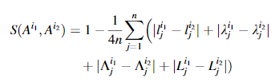
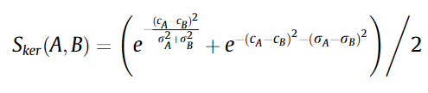







Merging Conditions
cluster overlap and similarity measures [3] (Kullback–Leibler divergence, Bhattacharyya distance[21]),
rule activation similarity [3],
distance between clusters (Welch test) [3,17,23,24] or granules [11],
consequent parameters comparison (steady-state gain) [3,25] etc.
[11]
[21]
[6]
[3]
[17]
[24]
[3]
[25]
[17]
[3]
[3] Dovžan, D., Logar, V., & Škrjanc, I. (2015). Implementation of an Evolving Fuzzy Model (eFuMo) in a Monitoring System for a Waste-Water Treatment Process. IEEE Transactions on Fuzzy Systems, 23(5), 1761–1776.
[11] Leite, D., Ballini, R., Costa, P., & Gomide, F. (2012). Evolving fuzzy granular modeling from nonstationary fuzzy data streams. Evolving Systems, 3(2), 65–79.
[17] Soleimani-B, H., Lucas, C., & Araabi, B. N. (2010). Recursive Gath-Geva clustering as a basis for evolving neuro-fuzzy modeling. Evolving Systems, 1(1), 59–71.
[21] Lughofer, E., & Sayed-Mouchaweh, M. (2015). Autonomous data stream clustering implementing split-and-merge concepts – Towards a plug-and-play approach. Information Sciences, 304, 54–79.
[23] E. Lima, M. Hell, R. Ballini, F. Gomide, Evolving fuzzy modeling using participatory learning, in: P. Angelov, D. Filev, N. Kasabov (Eds.), EvolvingIntelligent Systems: Methodology and Applications, John Wiley & Sons, New York, 2010, pp. 67–86.
[24] Lughofer, E., Bouchot, J. L., & Shaker, A. (2011). On-line elimination of local redundancies in evolving fuzzy systems. Evolving Systems, 2(3), 165–187.
[25] Andonovski, G., Lughofer, E., & Skrjanc, I. (2021). Evolving Fuzzy Model Identification of Nonlinear Wiener-Hammerstein Processes. IEEE Access, 9, 158470–158480.
Notes:
[5] Dovžan, D., Logar, V., & Škrjanc, I. (2015). Implementation of an Evolving Fuzzy Model (eFuMo) in a Monitoring System for a Waste-Water Treatment Process. IEEE Transactions on Fuzzy Systems, 23(5), 1761–1776.
[6] Lughofer, E., & Sayed-Mouchaweh, M. (2015). Autonomous data stream clustering implementing split-and-merge concepts – Towards a plug-and-play approach. Information Sciences, 304, 54–79.
[14] Soleimani-B, H., Lucas, C., & Araabi, B. N. (2010). Recursive Gath-Geva clustering as a basis for evolving neuro-fuzzy modeling. Evolving Systems, 1(1), 59–71.
[17] E. Lima, M. Hell, R. Ballini, F. Gomide, Evolving fuzzy modeling using participatory learning, in: P. Angelov, D. Filev, N. Kasabov (Eds.), EvolvingIntelligent Systems: Methodology and Applications, John Wiley & Sons, New York, 2010, pp. 67–86.
[19] Andonovski, G., Lughofer, E., & Skrjanc, I. (2021). Evolving Fuzzy Model Identification of Nonlinear Wiener-Hammerstein Processes. IEEE Access, 9, 158470–158480.
[54] Leite, D., Ballini, R., Costa, P., & Gomide, F. (2012). Evolving fuzzy granular modeling from nonstationary fuzzy data streams. Evolving Systems, 3(2), 65–79.
[20] Lughofer, E., Bouchot, J. L., & Shaker, A. (2011). On-line elimination of local redundancies in evolving fuzzy systems. Evolving Systems, 2(3), 165–187.

Slide 13
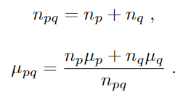
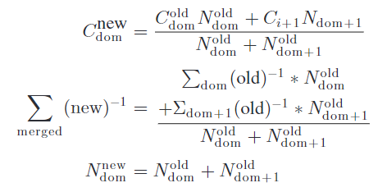
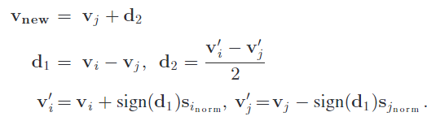


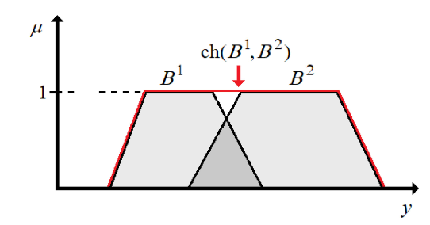
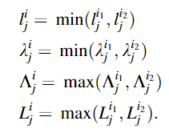
Merging
centre and covariance averaging [3,2,26]
convex hull [27,11].
[2]
[3]
[26]
[2] Skrjanc, I. (2020). Cluster-Volume-Based Merging Approach for Incrementally Evolving Fuzzy Gaussian Clustering-eGAUSS+. IEEE Transactions on Fuzzy Systems, 28(9), 2222–2231.
[3] Dovžan, D., Logar, V., & Škrjanc, I. (2015). Implementation of an Evolving Fuzzy Model (eFuMo) in a Monitoring System for a Waste-Water Treatment Process. IEEE Transactions on Fuzzy Systems, 23(5), 1761–1776.
[11] Leite, D., Ballini, R., Costa, P., & Gomide, F. (2012). Evolving fuzzy granular modeling from nonstationary fuzzy data streams. Evolving Systems, 3(2), 65–79.
[26] Pratama, M., Anavatti, S. G., & Lughofer, E. (2014). Genefis: Toward an effective localist network. IEEE Transactions on Fuzzy Systems, 22(3), 547–562.
[27] Garcia, C., Leite, D., & Skrjanc, I. (2020). Incremental Missing-Data Imputation for Evolving Fuzzy Granular Prediction. IEEE Transactions on Fuzzy Systems, 28(10), 2348–2362.
[27]
[22]
Notes:
[43] Skrjanc, I. (2020). Cluster-Volume-Based Merging Approach for Incrementally Evolving Fuzzy Gaussian Clustering-eGAUSS+. IEEE Transactions on Fuzzy Systems, 28(9), 2222–2231.
[51] Garcia, C., Leite, D., & Skrjanc, I. (2020). Incremental Missing-Data Imputation for Evolving Fuzzy Granular Prediction. IEEE Transactions on Fuzzy Systems, 28(10), 2348–2362.
[54] Leite, D., Ballini, R., Costa, P., & Gomide, F. (2012). Evolving fuzzy granular modeling from nonstationary fuzzy data streams. Evolving Systems, 3(2), 65–79.
[5] Dovžan, D., Logar, V., & Škrjanc, I. (2015). Implementation of an Evolving Fuzzy Model (eFuMo) in a Monitoring System for a Waste-Water Treatment Process. IEEE Transactions on Fuzzy Systems, 23(5), 1761–1776.
[56]Pratama, M., Anavatti, S. G., & Lughofer, E. (2014). Genefis: Toward an effective localist network. IEEE Transactions on Fuzzy Systems, 22(3), 547–562. https://doi.org/10.1109/TFUZZ.2013.2264938

Slide 14




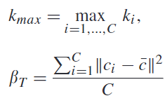
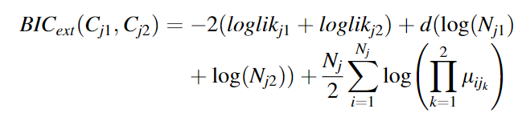
Razcep Rojev
Inappropriate merging parameters, data stream concept drifts and abrupt shifts, better space partitioning etc.
Accumulated model error [3],
Welchejev T-test (Welch T-test)[21], Bayesian information criterion [21, 27], partition separation index [22] etc.
[3]
[21]
[22]
[27]
[3] Dovžan, D., Logar, V., & Škrjanc, I. (2015). Implementation of an Evolving Fuzzy Model (eFuMo) in a Monitoring System for a Waste-Water Treatment Process. IEEE Transactions on Fuzzy Systems, 23(5), 1761–1776.
[21] Lughofer, E., & Sayed-Mouchaweh, M. (2015). Autonomous data stream clustering implementing split-and-merge concepts – Towards a plug-and-play approach. Information Sciences, 304, 54–79.
[22] Lughofer, E. (2008). Extensions of vector quantization for incremental clustering. Pattern Recognition, 41(3), 995–1011.
[27] Garcia, C., Leite, D., & Skrjanc, I. (2020). Incremental Missing-Data Imputation for Evolving Fuzzy Granular Prediction. IEEE Transactions on Fuzzy Systems, 28(10), 2348–2362.
Notes:
[5] Dovžan, D., Logar, V., & Škrjanc, I. (2015). Implementation of an Evolving Fuzzy Model (eFuMo) in a Monitoring System for a Waste-Water Treatment Process. IEEE Transactions on Fuzzy Systems, 23(5), 1761–1776.
[6] Lughofer, E., & Sayed-Mouchaweh, M. (2015). Autonomous data stream clustering implementing split-and-merge concepts – Towards a plug-and-play approach. Information Sciences, 304, 54–79.
[51] Garcia, C., Leite, D., & Skrjanc, I. (2020). Incremental Missing-Data Imputation for Evolving Fuzzy Granular Prediction. IEEE Transactions on Fuzzy Systems, 28(10), 2348–2362.
[53] Lughofer, E. (2008). Extensions of vector quantization for incremental clustering. Pattern Recognition, 41(3), 995–1011.

Slide 15

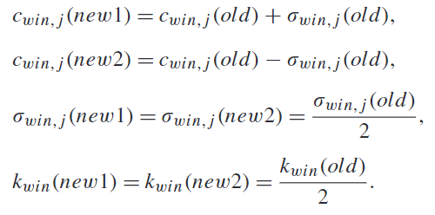
Cluster Splitting
Gaussian mixture model [27],
largest covariance matrix eigenvalue, number of samples halved [3, 22].
Model quality can be check after the split [19].
[3]
[22]
[3] Dovžan, D., Logar, V., & Škrjanc, I. (2015). Implementation of an Evolving Fuzzy Model (eFuMo) in a Monitoring System for a Waste-Water Treatment Process. IEEE Transactions on Fuzzy Systems, 23(5), 1761–1776
[19] Lughofer, E. D. (2008). FLEXFIS: A robust incremental learning approach for evolving Takagi-Sugeno fuzzy models. IEEE Transactions on Fuzzy Systems, 16(6), 1393–1410.
[22] Lughofer, E. (2008). Extensions of vector quantization for incremental clustering. Pattern Recognition, 41(3), 995–1011.
[27] Garcia, C., Leite, D., & Skrjanc, I. (2020). Incremental Missing-Data Imputation for Evolving Fuzzy Granular Prediction. IEEE Transactions on Fuzzy Systems, 28(10), 2348–2362.
Notes:
[49] Lughofer, E. D. (2008). FLEXFIS: A robust incremental learning approach for evolving Takagi-Sugeno fuzzy models. IEEE Transactions on Fuzzy Systems, 16(6), 1393–1410.
[53] Lughofer, E. (2008). Extensions of vector quantization for incremental clustering. Pattern Recognition, 41(3), 995–1011.
[51] Garcia, C., Leite, D., & Skrjanc, I. (2020). Incremental Missing-Data Imputation for Evolving Fuzzy Granular Prediction. IEEE Transactions on Fuzzy Systems, 28(10), 2348–2362.
[5] Dovžan, D., Logar, V., & Škrjanc, I. (2015). Implementation of an Evolving Fuzzy Model (eFuMo) in a Monitoring System for a Waste-Water Treatment Process. IEEE Transactions on Fuzzy Systems, 23(5), 1761–1776.

Slide 16




Cluster Removal
Outliers are similar to cyclical and periodic events, which contain large information $→u$seful information might be discarded [20].
age of clusters [3,12],
utility, accumulated activation, rare activations, insignificance [10, 12, 28, 29],
number of samples belonging to clusters [3,20] etc.
[8]
[28]
[3] Dovžan, D., Logar, V., & Škrjanc, I. (2015). Implementation of an Evolving Fuzzy Model (eFuMo) in a Monitoring System for a Waste-Water Treatment Process. IEEE Transactions on Fuzzy Systems, 23(5), 1761–1776.
[8] Lughofer, E. (2013). On-line assurance of interpretability criteria in evolving fuzzy systems – Achievements, new concepts and open issues. Information Sciences, 251, 22–46
[10] Angelov, P. P., Gu, X., & Principe, J. C. (2018). Autonomous learning multimodel systems from data streams. IEEE Transactions on Fuzzy Systems, 26(4), 2213–2224.
[12] Angelov, P., & Yager, R. (2011). Simplified fuzzy rule-based systems using non-parametric antecedents and relative data density. IEEE SSCI 2011: Symposium Series on Computational Intelligence - EAIS 2011: 2011 IEEE Workshop on Evolving and Adaptive Intelligent Systems, 62–69.
[20] Andonovski, G., Mušič, G., Blažič, S., & Škrjanc, I. (2018). Evolving model identification for process monitoring and prediction of non-linear systems. Engineering Applications of Artificial Intelligence, 68, 214–221.
[28] Rong, H. J., Sundararajan, N., Huang, G. bin, & Saratchandran, P. (2006). Sequential Adaptive Fuzzy Inference System (SAFIS) for nonlinear system identification and prediction. Fuzzy Sets and Systems, 157(9), 1260–1275.
[29] Leite, D., & Škrjanc, I. (2019). Ensemble of evolving optimal granular experts, OWA aggregation, and time series prediction. Information Sciences, 504, 95–112.
Notes:
[48] Leite, D., & Škrjanc, I. (2019). Ensemble of evolving optimal granular experts, OWA aggregation, and time series prediction. Information Sciences, 504, 95–112.
[41] Angelov, P., & Yager, R. (2011). Simplified fuzzy rule-based systems using non-parametric antecedents and relative data density. IEEE SSCI 2011: Symposium Series on Computational Intelligence - EAIS 2011: 2011 IEEE Workshop on Evolving and Adaptive Intelligent Systems, 62–69.
[45] Angelov, P. P., Gu, X., & Principe, J. C. (2018). Autonomous learning multimodel systems from data streams. IEEE Transactions on Fuzzy Systems, 26(4), 2213–2224.
[22] Rong, H. J., Sundararajan, N., Huang, G. bin, & Saratchandran, P. (2006). Sequential Adaptive Fuzzy Inference System (SAFIS) for nonlinear system identification and prediction. Fuzzy Sets and Systems, 157(9), 1260–1275.
[5] Dovžan, D., Logar, V., & Škrjanc, I. (2015). Implementation of an Evolving Fuzzy Model (eFuMo) in a Monitoring System for a Waste-Water Treatment Process. IEEE Transactions on Fuzzy Systems, 23(5), 1761–1776.
[39] Andonovski, G., Mušič, G., Blažič, S., & Škrjanc, I. (2018). Evolving model identification for process monitoring and prediction of non-linear systems. Engineering Applications of Artificial Intelligence, 68, 214–221.

Slide 17
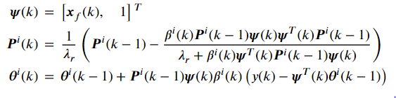
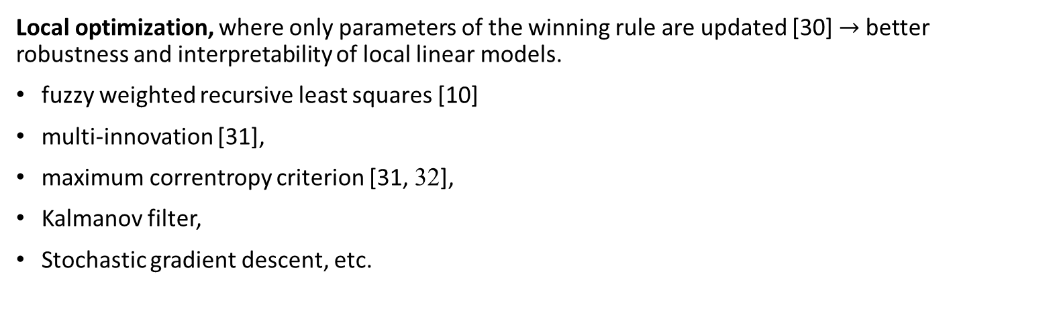
Consequent Parameter
Optimization
Local optimization, where only parameters of the winning rule are updated [30] $→$better robustness and interpretability of local linear models.
fuzzy weighted recursive least squares [10]
multi-innovation [31],
maximum correntropy criterion [31, 32],
Kalmanov filter,
Stochastic gradient descent, etc.
[10] Angelov, P. P., Gu, X., & Principe, J. C. (2018). Autonomous learning multimodel systems from data streams. IEEE Transactions on Fuzzy Systems, 26(4), 2213–2224.
[30] Nelles, O. (2001). Nonlinear System Identification. Nonlinear System Identification.
[31] Lughofer, E. (2021). Improving the robustness of recursive consequent parameters learning in evolving neuro-fuzzy systems. Information Sciences, 545, 555–574.
[32] Bao, R. J., Rong, H. J., Angelov, P. P., Chen, B., & Wong, P. K. (2018). Correntropy-Based Evolving Fuzzy Neural System. IEEE Transactions on Fuzzy Systems, 26(3), 1324–1338.
Notes:
auxiliary model – Replacing an unmeasurable variable (like the noise) in the regressor/information matrix by using an estimation of the variable instead of the real value.
Hierhical principle – decomposes the system into multiple where multiple regressors are used in every optimization. ( used to identify multivariable systems or noise transfer functions).
Combining both approaches an unknown variable can be optimized in one optimization, used to estimate another regression variable and finally used in another optimization.
instrumental variables – the output of the system is replaced by the model prediction (both are present)
Correntropy - a Mercer's kernel (usually Gaussian) of the error values in the optimization criteria function used to lower the effect of outlier samples [47].
[15] Nelles, O. (2001). Nonlinear System Identification. Nonlinear System Identification.
[45] Angelov, P. P., Gu, X., & Principe, J. C. (2018). Autonomous learning multimodel systems from data streams. IEEE Transactions on Fuzzy Systems, 26(4), 2213–2224.
[47] Lughofer, E. (2021). Improving the robustness of recursive consequent parameters learning in evolving neuro-fuzzy systems. Information Sciences, 545, 555–574.
[55] Bao, R. J., Rong, H. J., Angelov, P. P., Chen, B., & Wong, P. K. (2018). Correntropy-Based Evolving Fuzzy Neural System. IEEE Transactions on Fuzzy Systems, 26(3), 1324–1338.

Slide 18
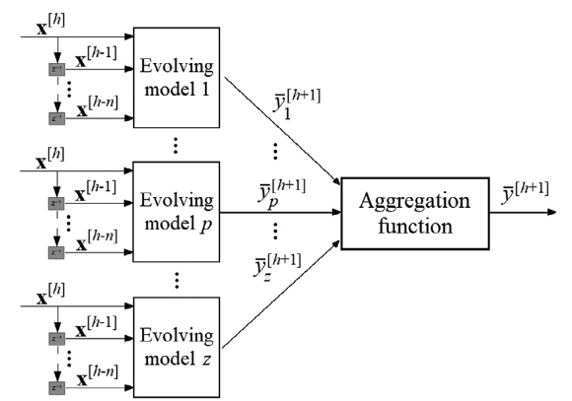
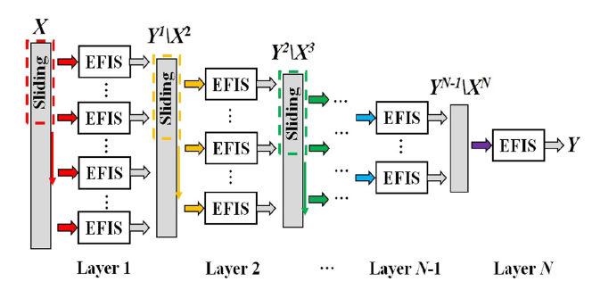

Evolving Ensemble
[29]
Učenje več različnih samorazvijajočih se modelov na istem problemu z različnimi parametri [6, 29]$→$Ensemble learning.
Posamezni samorazvijajoči se mode li v ansamblu se lahko razlikujejo po: strukturi, številu parametrov, omejitvah (constraints), kriterijski funkciji, tipu samorazvijajočega se modela.
Extreme Learning Machines (ELMs) (2009) (naključna inicializacija parametrov in strukture)
Parsimonious ensemble (pENsemble) (2018) (model removal and )
Ensamble of Fuzzy-set-Based evolving Models (FBeM) (2015) (različni parametri in strukture informacijskih granul)
Ensamble of optimal evolving granular experts (eOGS) (2019) [29] (uses multiple aggregation functions)
Multilayer ensemble evolving fuzzy inference system MEEFIS (2019) [33] (samorazvijajoči se modeli kot gradniki omrežja)
[33]
[6] Leite, D., Škrjanc, I., & Gomide, F. (2020). An overview on evolving systems and learning from stream data. Evolving Systems, 11(2), 181–198.
[29] Leite, D., & Škrjanc, I. (2019). Ensemble of evolving optimal granular experts, OWA aggregation, and time series prediction. Information Sciences, 504, 95–112.
[33] Gu, X. (2021). Multilayer Ensemble Evolving Fuzzy Inference System. IEEE Transactions on Fuzzy Systems, 29(8), 2425–2431.
Notes:
Ansambel/skupina (Ensamble learning) modelov je sestavljena iz več različnih samorazvijajočih se modelov, ki jih paralelno učimo na istem problemu z različnimi parametri [10, 48]. Posamezni samorazvijajoči se modeli v ansamblu se lahko razlikujejo po strukturi, številu parametrov, različnih omejitvah, kriterijski funkciji ali celo tipu modela. Extreme Learning Machines (ELMs) (2009) (naključna inicializacija parametrov in strukture)
Ansambli samorazvijajočih se modelov v obliki omrežja [44].
[10] Leite, D., Škrjanc, I., & Gomide, F. (2020). An overview on evolving systems and learning from stream data. Evolving Systems, 11(2), 181–198.
[44] Gu, X. (2021). Multilayer Ensemble Evolving Fuzzy Inference System. IEEE Transactions on Fuzzy Systems, 29(8), 2425–2431.
[48] Leite, D., & Škrjanc, I. (2019). Ensemble of evolving optimal granular experts, OWA aggregation, and time series prediction. Information Sciences, 504, 95–112.

Slide 19
Evolving Systems Open Issues
Managing missing data and outliers,
Theorems for long term convergence,
Design of Experiments,
Workflow,
Online performance metrics,
Parallelization,
Soft sensors,
Feature selection, etc.
[6] Leite, D., Škrjanc, I., & Gomide, F. (2020). An overview on evolving systems and learning from stream data. Evolving Systems, 11(2), 181–198.
[34] Škrjanc, I., Iglesias, J., Sanchis, A., Leite, D., Lughofer, E., & Gomide, F. (2019). Evolving fuzzy and neuro-fuzzy approaches in clustering, regression, identification, and classification: A Survey. Information Sciences, 490, 344–368
Notes:
[10] Leite, D., Škrjanc, I., & Gomide, F. (2020). An overview on evolving systems and learning from stream data. Evolving Systems, 11(2), 181–198.
[27] Škrjanc, I., Iglesias, J., Sanchis, A., Leite, D., Lughofer, E., & Gomide, F. (2019). Evolving fuzzy and neuro-fuzzy approaches in clustering, regression, identification, and classification: A Survey. Information Sciences, 490, 344–368

Slide 20

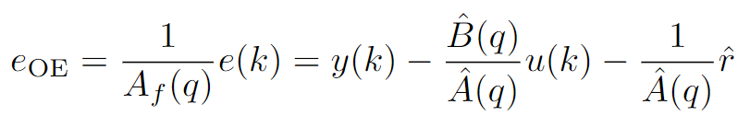
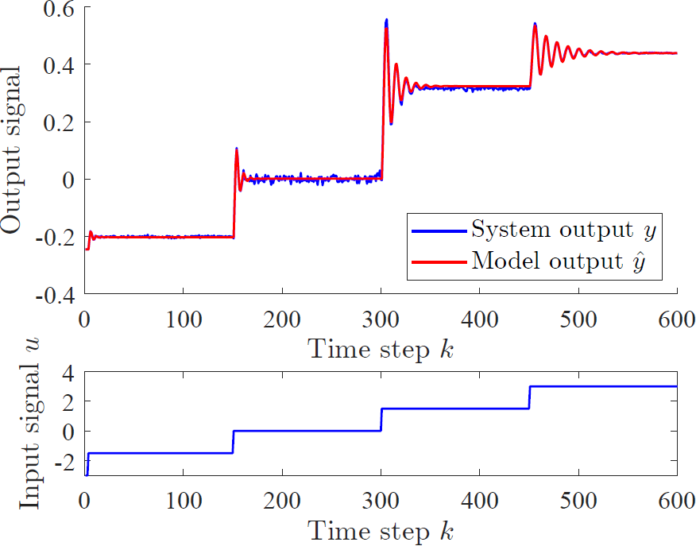
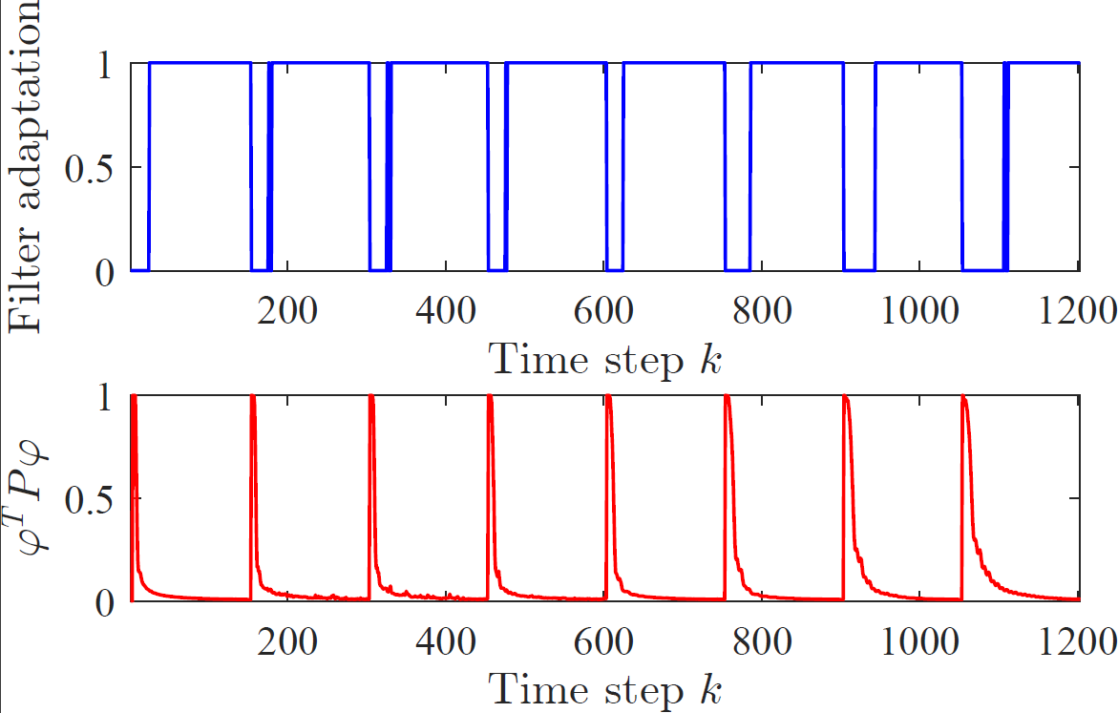

Adaptiranje filtra z intervalom zaupanja

Slide 21
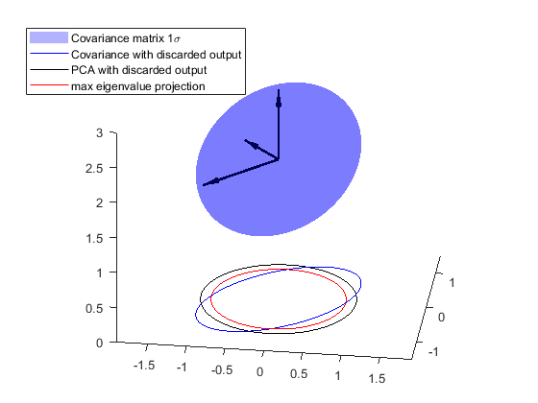
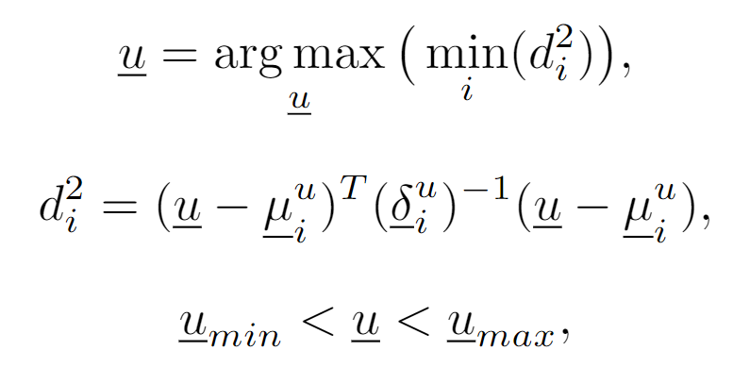
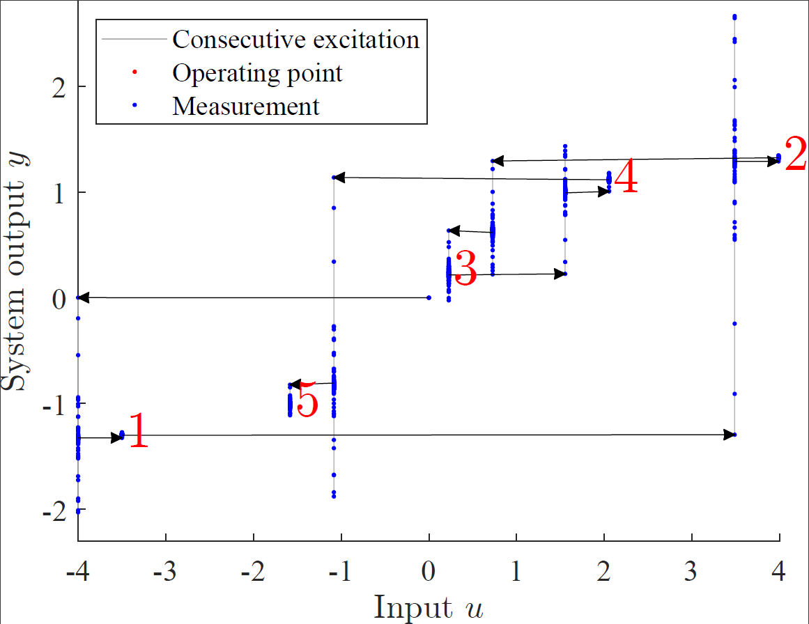
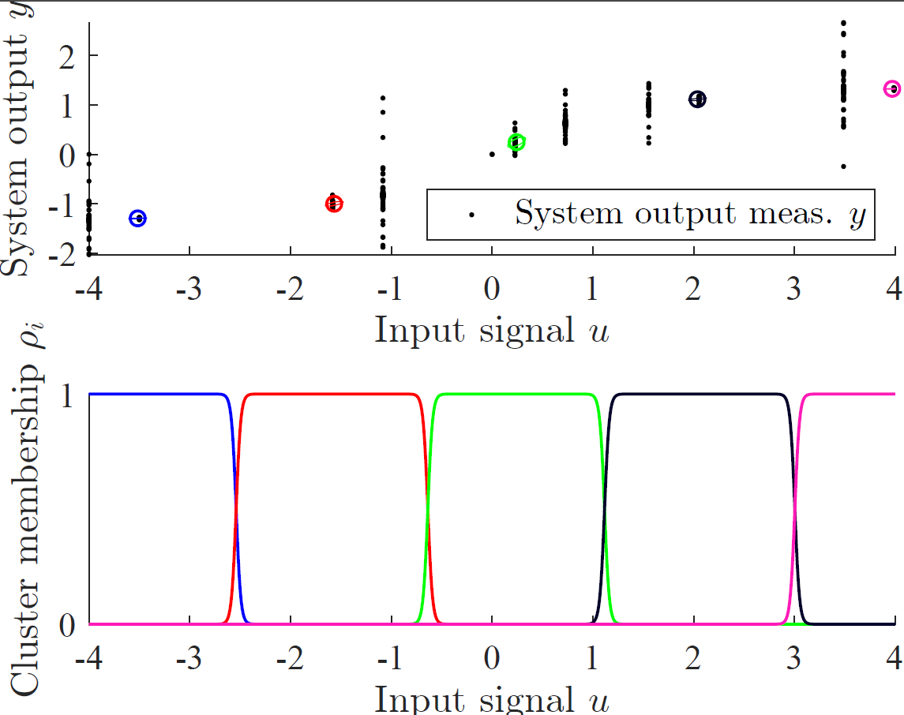
Hevristično zaporedje štopničastih vzbujanj

Slide 22
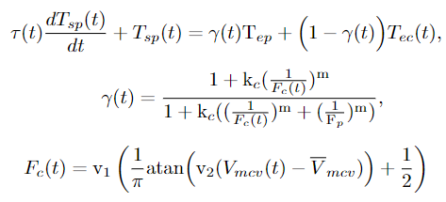


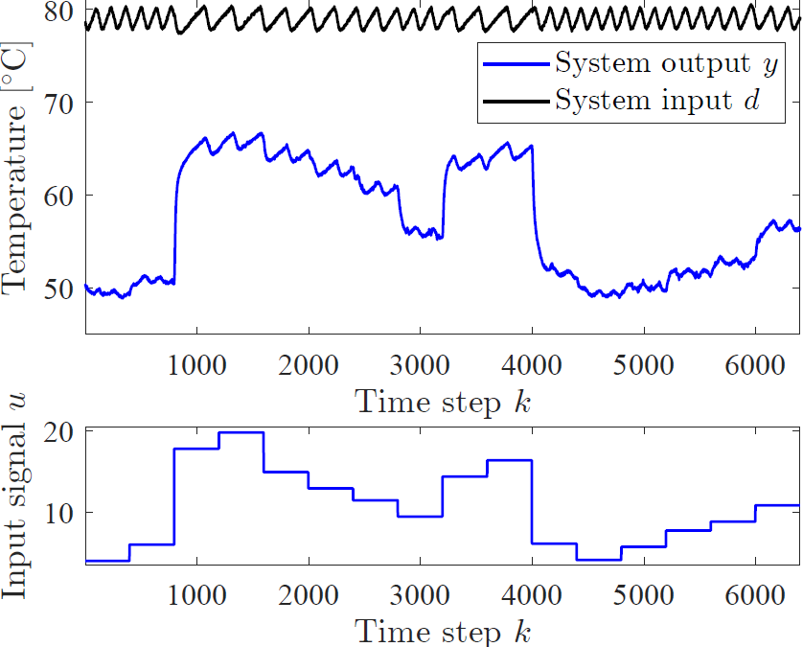
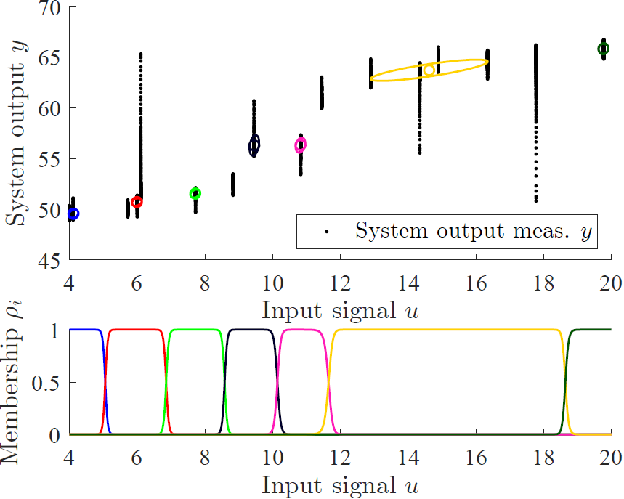
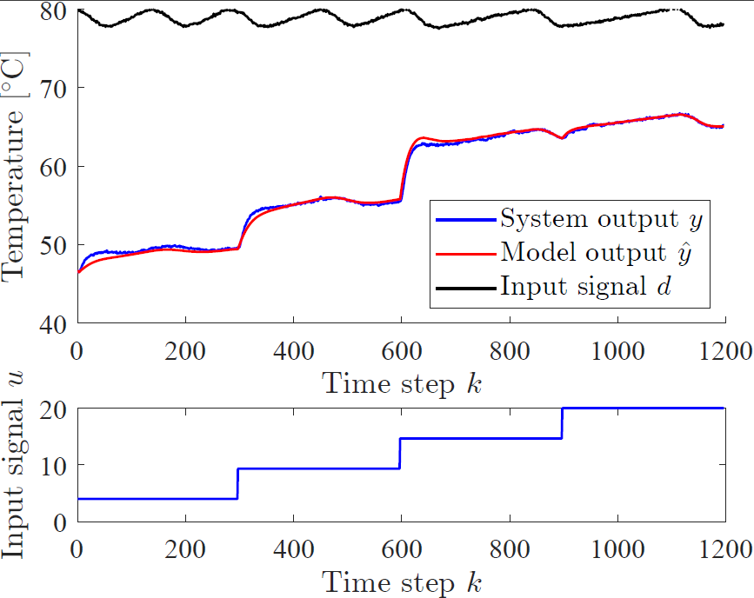
Ploskovni toplotni izmenjevalec

